Slide 1
ALU Design Project
Youzhe Dou, Yulong Wang, Howard Xu

Slide 2
Overview
Register
ALU
Control Unit

Slide 3
Register
24 bits
Load, clear, increment and shifts
Bit-Slice
Schematic
Layout
24-bit Register File
Simulation
Schematic
Layout

Slide 4
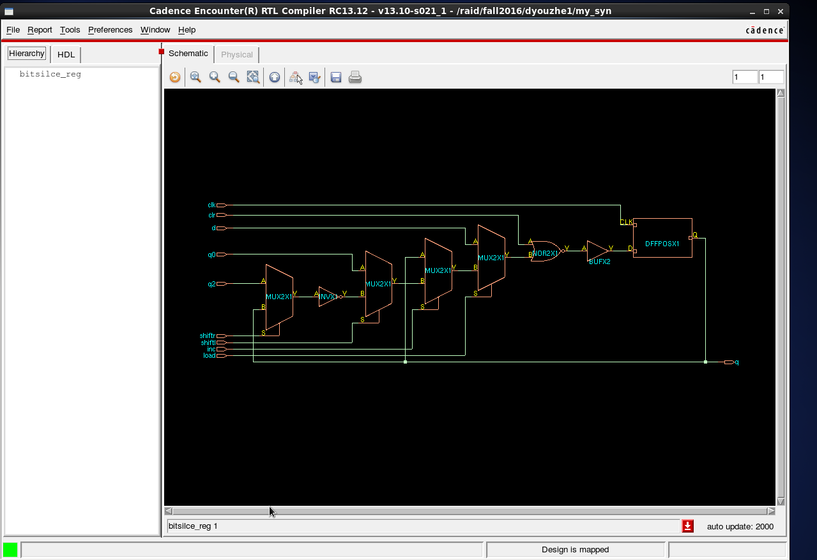
Bit-Slice Schematic

Slide 5
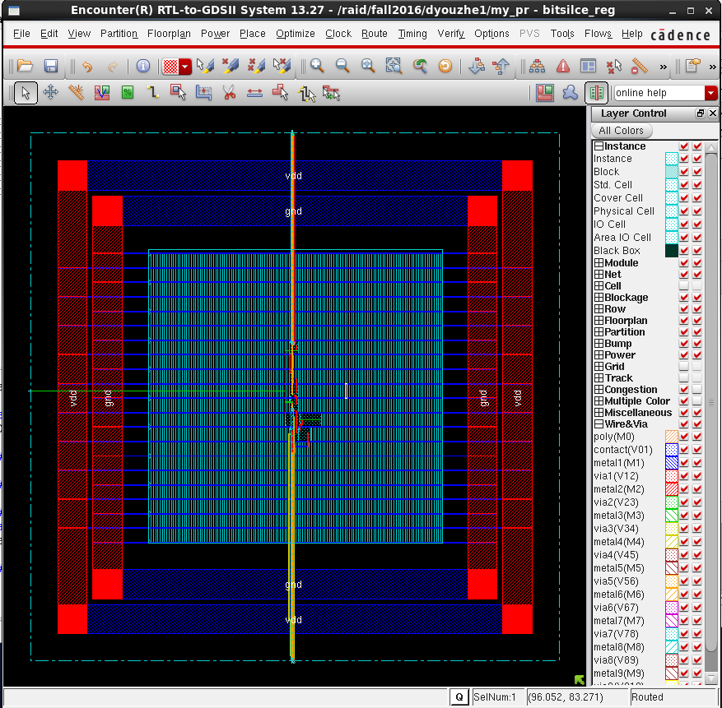
Bit-Slice Layout

Slide 6
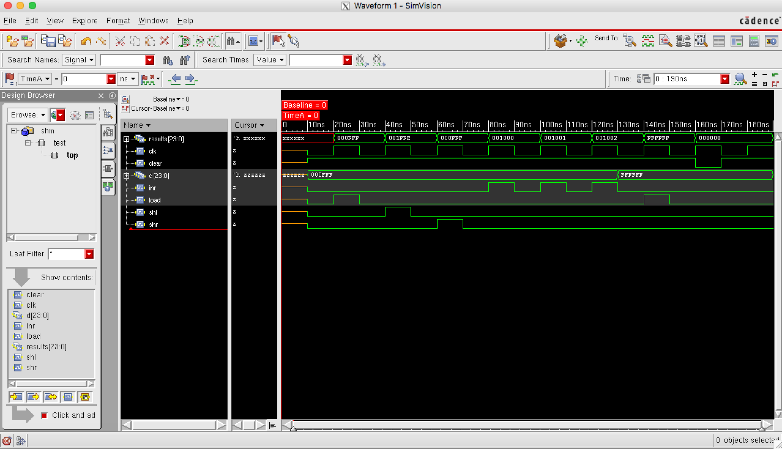
Register Simulation

Slide 7
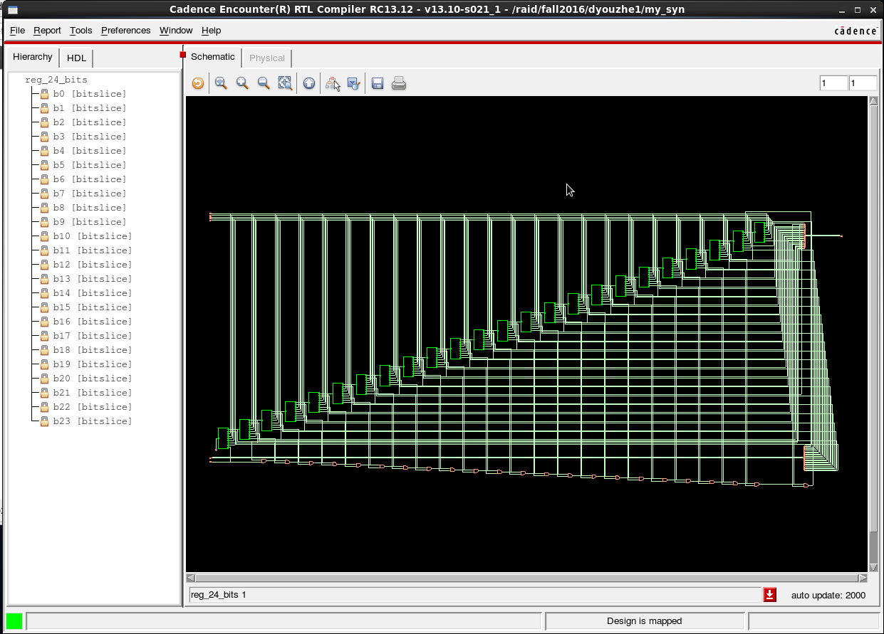
Register Schematic

Slide 8
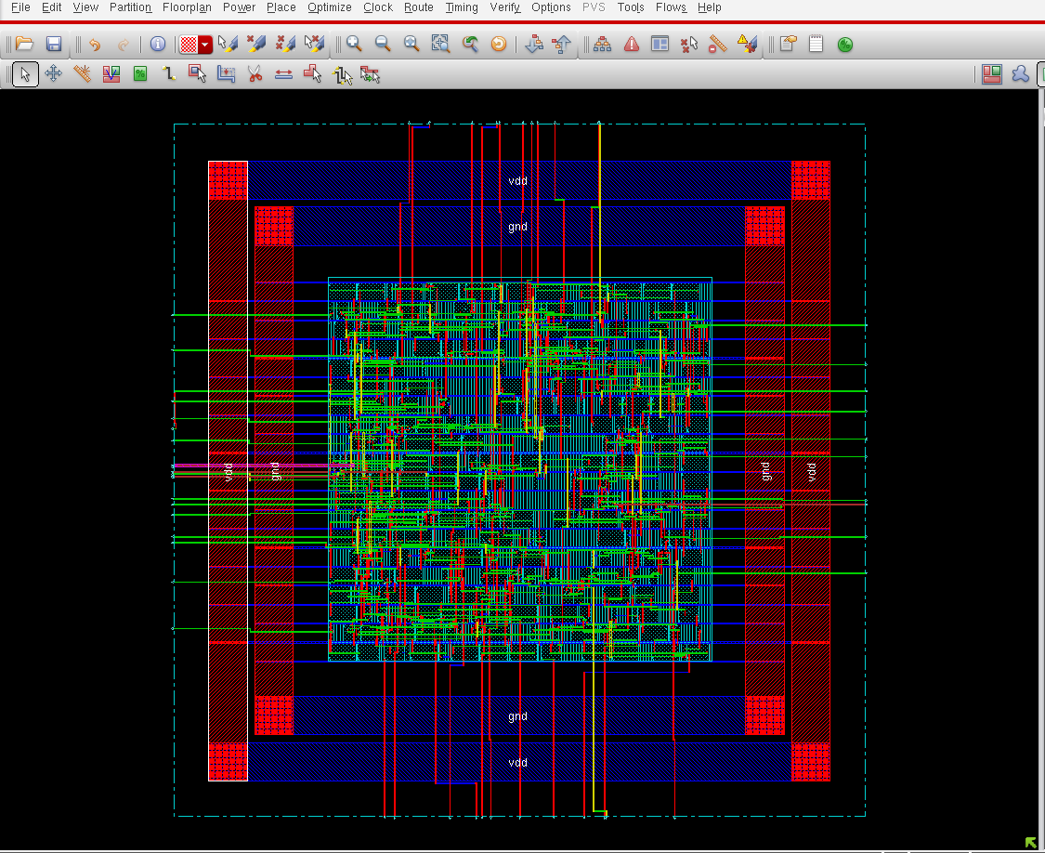
Register Layout

Slide 9
ALU
000: AC = NOT(AC)
001: AC = AND (DR1, DR2)
010: AC = OR(DR1, DR2)
011: AC = XOR(DR1, DR2)
100: AC = ADD(DR1, DR2)
101: AC = NEG (two’s complement, DR2)
110: AC = SUB (DR1, DR2)
AC = SHR(AC); DR1=SHR(DR1); DR2=SHR(DR2)
AC = SHL(AC); DR1=SHL(DR1); DR2=SHL(DR2)

Slide 10
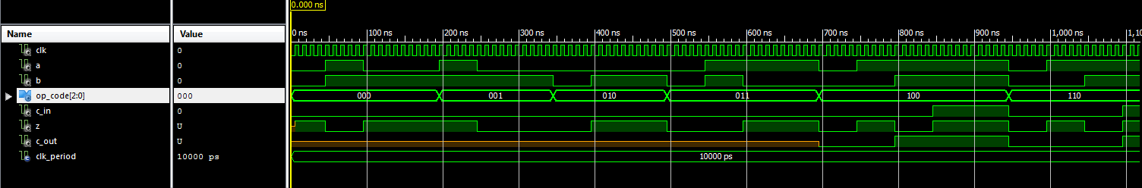
Bit-Slice Simulation
NOT(A) AND(A,B) OR(A,B) XOR(A,B) ADD(A,B) SUB(A,B)

Slide 11
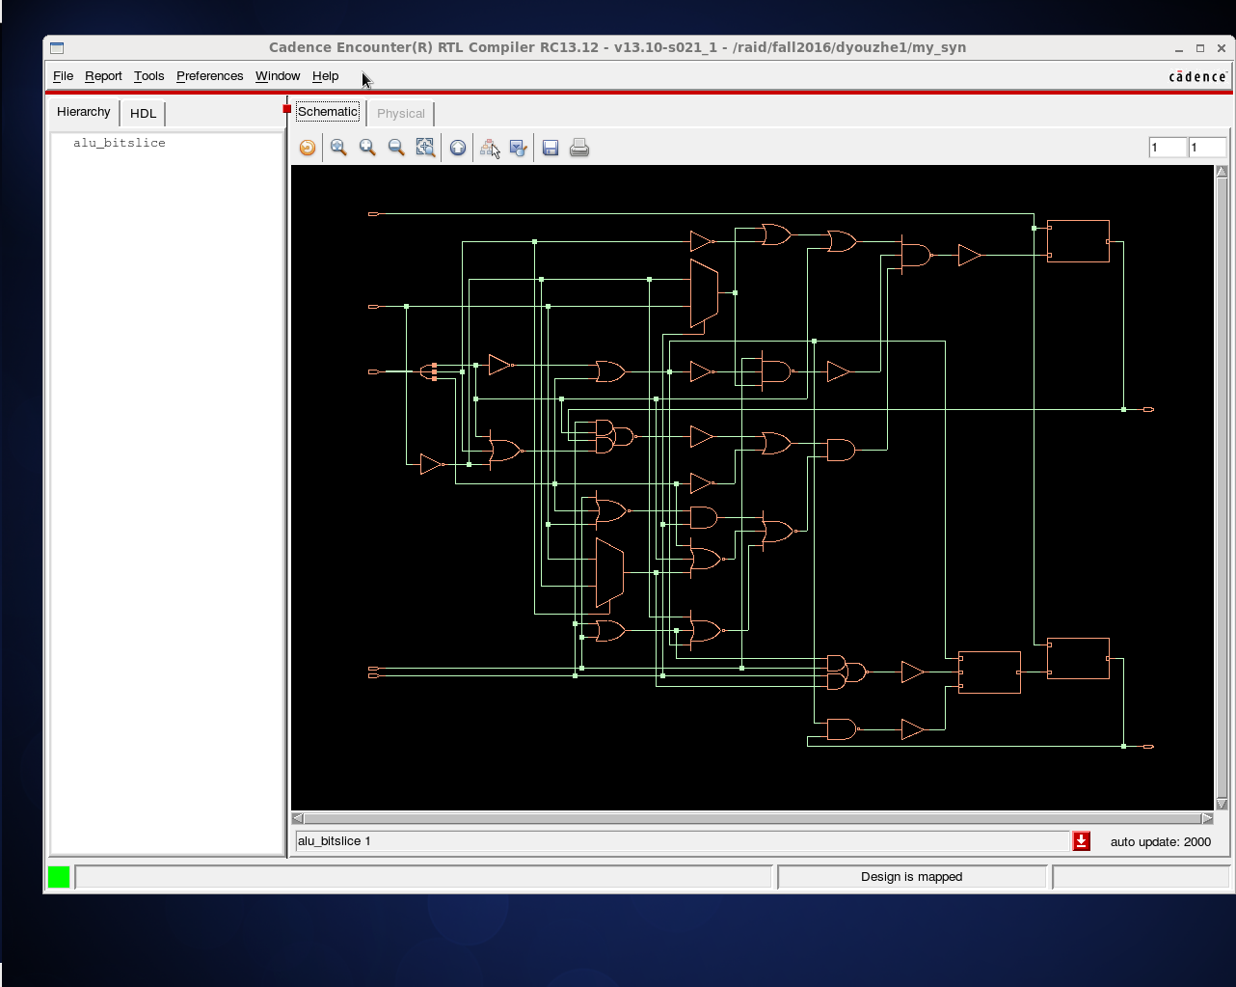
Bit-Slice Schematic

Slide 12
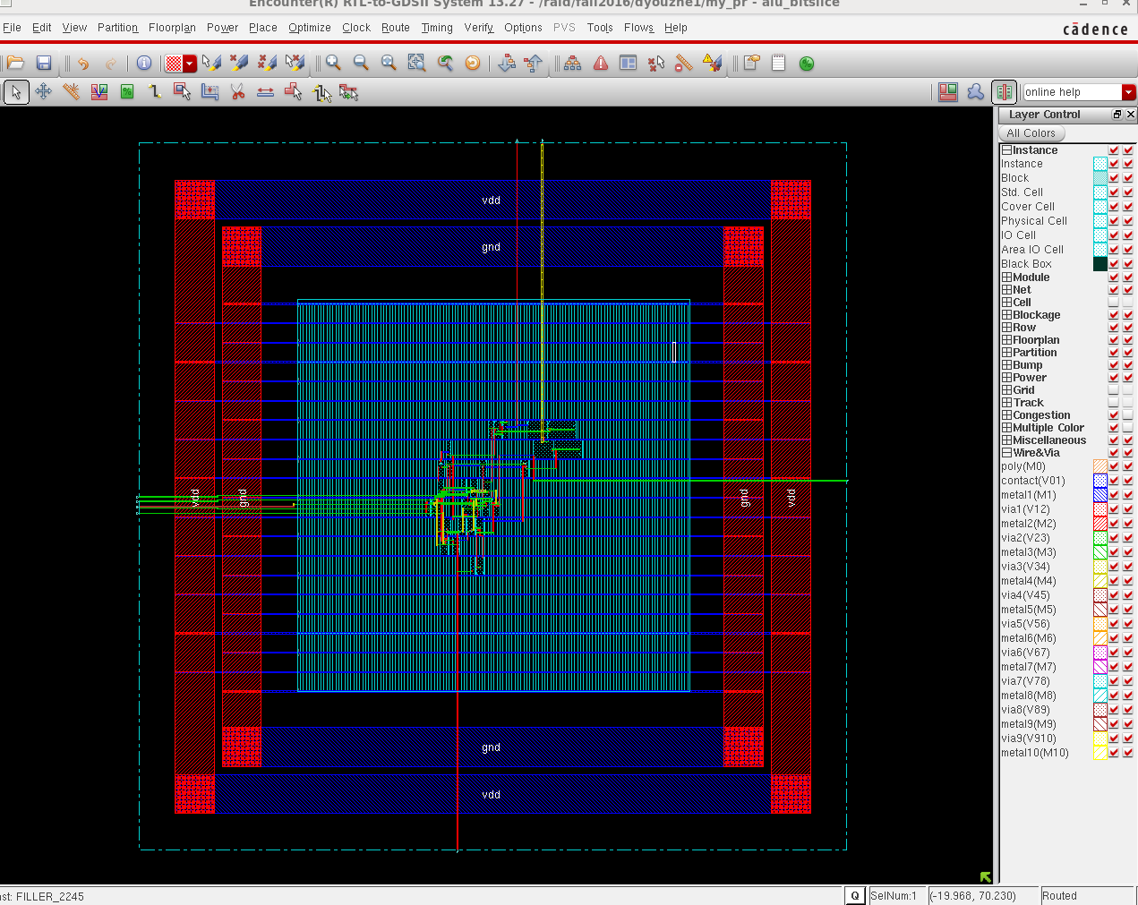
Bit-Slice Layout

Slide 13
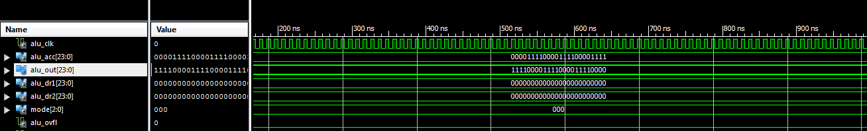
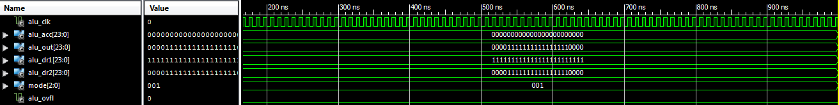
ALU Simulation
000: NOT
001: AND

Slide 14
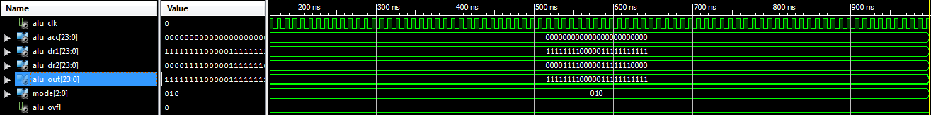
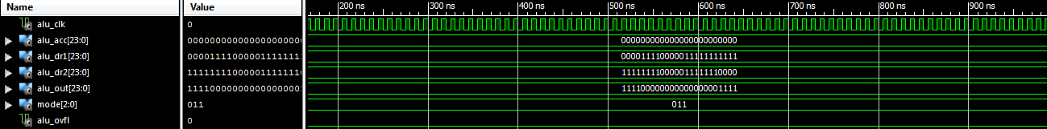
ALU Simulation
010: OR
011: XOR

Slide 15
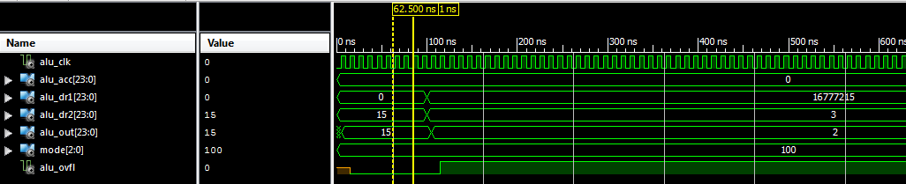
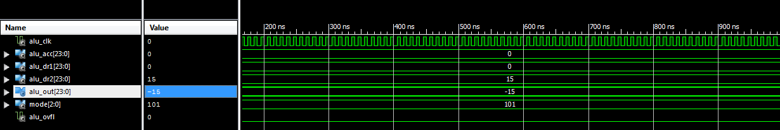
ALU Simulation
100: ADD
101: NEG

Slide 16
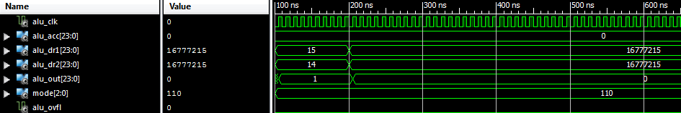
ALU Simulation
110: SUB

Slide 17
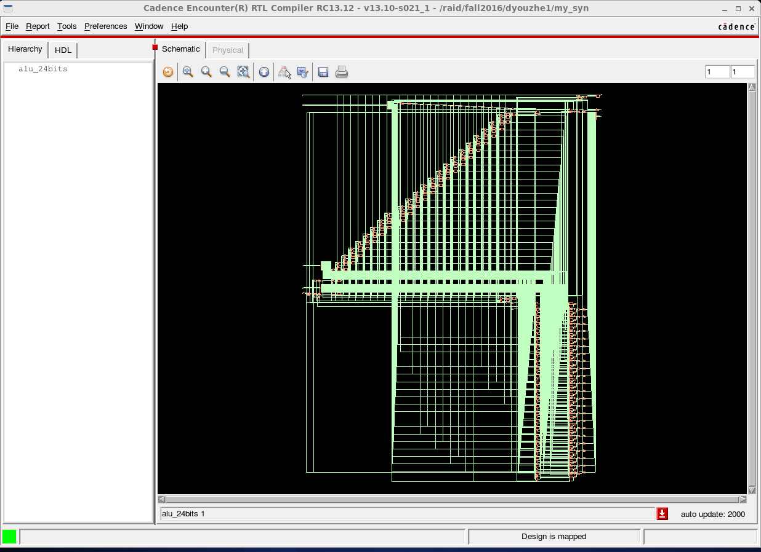
ALU Schematic

Slide 18
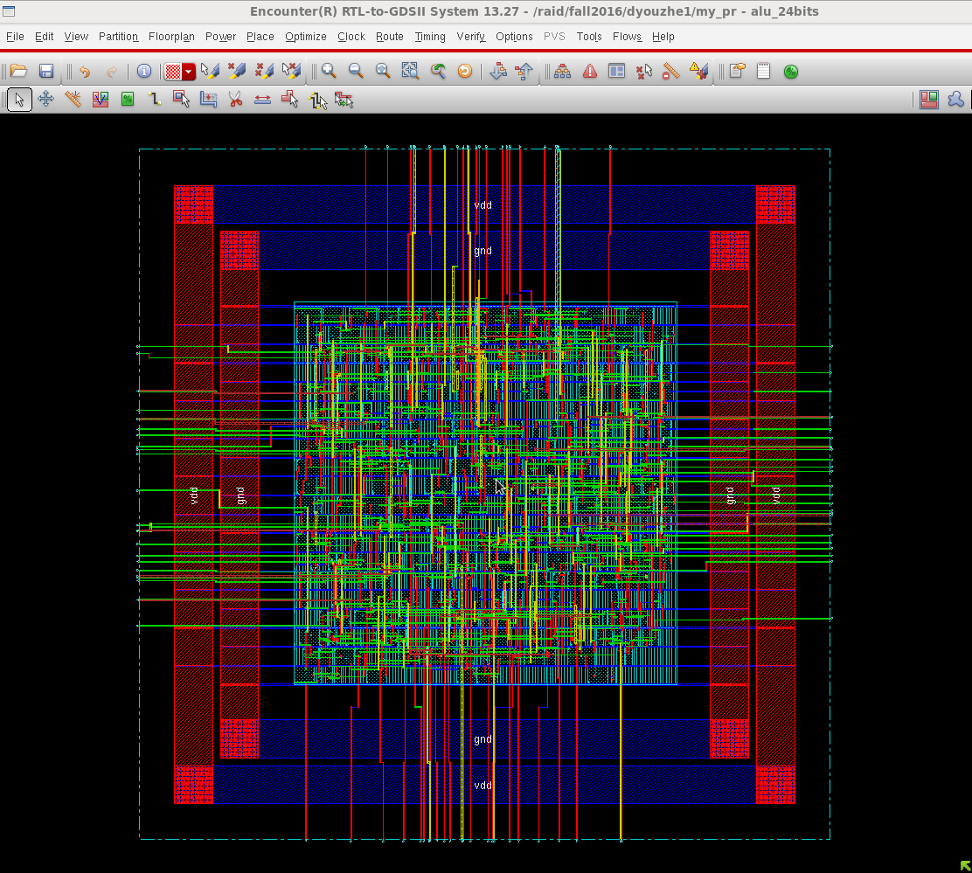
ALU Layout

